Slide 1
Vision
Kenneth Church
September, 2025

Slide 2
Agenda
Macro (Large Market Forces)
Micro (Personal Research)
Moore’s Law: Everything is getting better
but at different rates
Peak Data:
Scaling laws assume unlimited data
Language data: limited by population bound
Who can afford to play?
Narrative: Big companies with deep pockets
DeepSeek showed anyone can contribute
Clouds → Phones
Inference >> Training
“Diseconomies of scale”
Implications for global warming
Unify LLMs and Linear Algebra
SVD with Batching
Better Together
Academic Search
BERT Embeddings of Papers
Spectral Clustering of Citations
Loss Functions
Entropy: Predict the next word
Nuclear Norm: within → across
Low Resource Languages →
Growth Opportunities
Target languages with future demand
Many speakers and impressive GDP growth

Slide 4

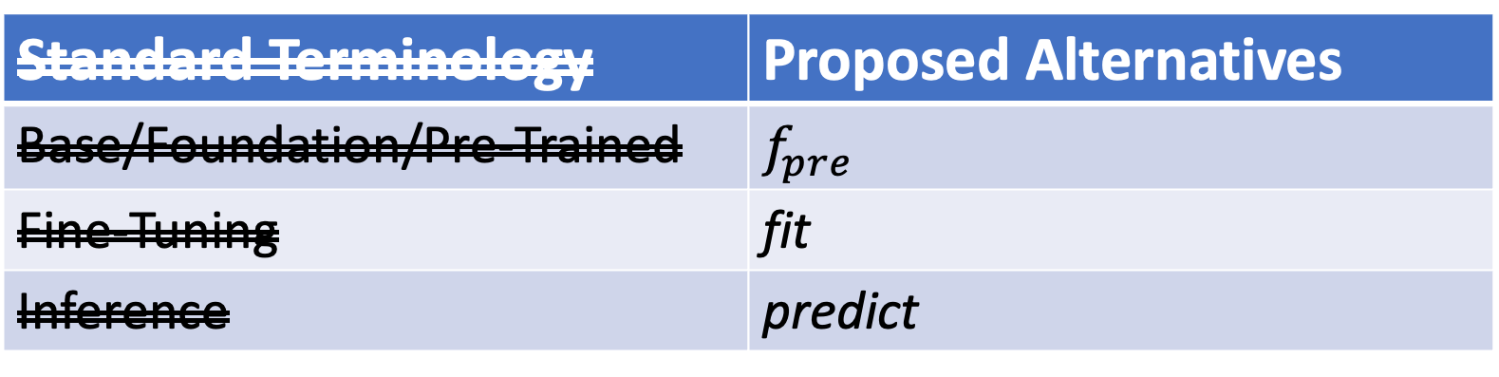
Why Change Terminology?
More opportunity for academics
& Computational Linguistics
Standard Terminology | Proposed Alternatives
Base/Foundation/Pre-Trained | $$f_{pre}$$
Fine-Tuning | fit
Inference | predict
Not this
Emphasize this
Emphasize this
https://www.youtube.com/watch?v=dG628PEN1fY
Industry has an unfair advantage over academia
Pre-training requires $$$$, Big Data & Logistics:
Big Investments → Risk Adverse → Less Creativity

Slide 5
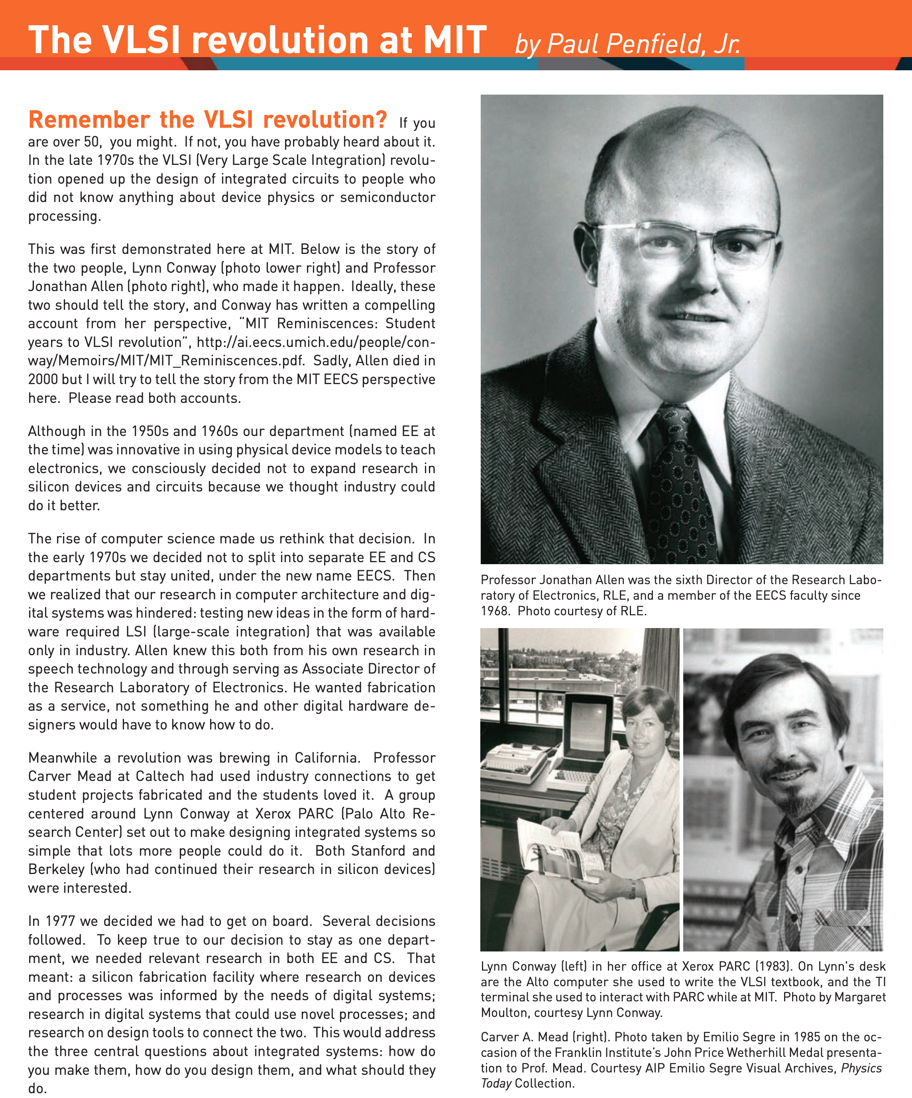
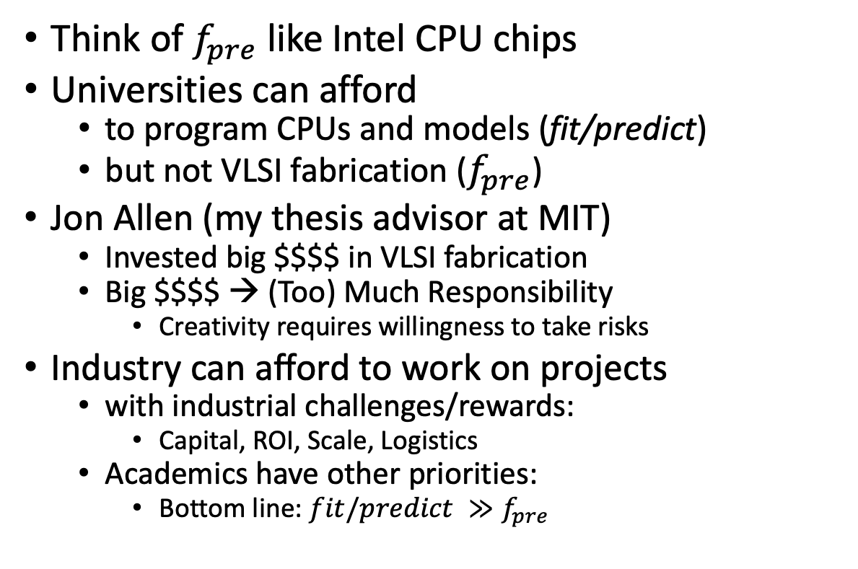
VLSI History http://www.eecs.mit.edu/docs/newsletter/VLSI.pdf http://ai.eecs.umich.edu/people/conway/Memoirs/MIT/MIT_Reminiscences.pdf
Perspective from MIT and beyond:
IBM, Silicon Valley, Mich, LGBTQ, etc.
Think of $f_{pre}$ like Intel CPU chips
Universities can afford
to program CPUs and models (fit/predict)
but not VLSI fabrication ($f_{pre}$)
Jon Allen (my thesis advisor at MIT)
Invested big $$$$ in VLSI fabrication
Big $$$$ → (Too) Much Responsibility
Creativity requires willingness to take risks
Industry can afford to work on projects
with industrial challenges/rewards:
Capital, ROI, Scale, Logistics
Academics have other priorities:
Bottom line: $fit/predict ≫f_{pre}$

